Slide 1
Global China Connection 2018 Introduction

Slide 2
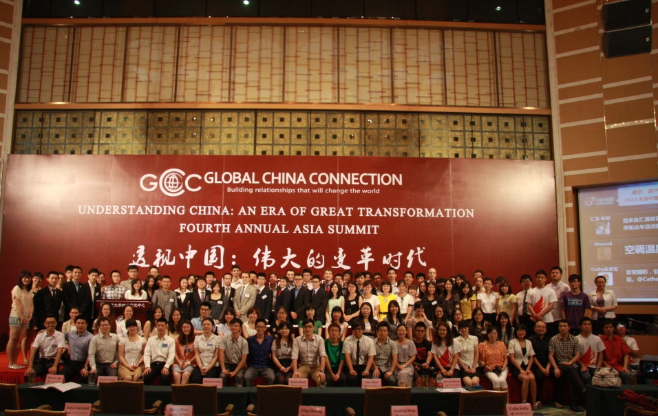
What if President Donald Trump and President Xi Jinping had known each other – and they had already worked together from a young age on a common goal?
1

Slide 3
Who We Are
Mission
To build deep, trusting relationships among Chinese and non-Chinese young people, so that future leaders can draw upon decades of friendship to manage the issues of the day.
Vision
To be the most respected, sought after, and far-reaching link between future leaders from China and the rest of the world.
GCC friendships will make significant contributions to China’s rise as a respected and responsible international power.
Our Values
Student Leadership – We recruit and train high potential college students who will become future leaders, and also believe that students can make an impact today
Diverse Friendships – We hold a passion for making friends of different backgrounds and from around the world
Global Collaboration – We have the desire and gumption to engage others anywhere and everywhere in order to reach our shared goals
Personal Responsibility – We take ownership of our work and operate with unfailing integrity
Resourceful Agility – We take cutting-edge techniques and technology and make them the standard practice; we take scarce resources and deliver a bounty
2

Slide 4
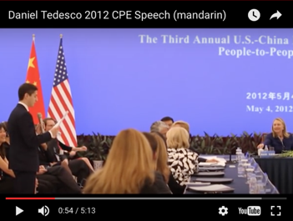
How We Work
Washington D.C.-registered 501c(3) nonprofit, nonpartisan organization
2,000+ active student members, 7000+ alumni
100+ local and global events per year
50+ university chapters across North America, Europe, Asia and Pacific, and the Middle East
Then-GCC President Daniel Tedesco introduced GCC in Mandarin to then-Secretary of State Hillary Clinton and then-State Councilor Liu Yandong in 2012
Watch on Youtube
2008: Founded at Columbia University
2009: First annual conferences in New York and Beijing
2010: Expanded to U.S. West Coast, Canada, France, Hong Kong
2011: Reached 50 university chapters
2013: Community reached 2,000 members and alumni
2014: Hosted 12 conferences around the world; developed first long-term strategic plan
2015: Earned 501c(3) Nonprofit status
2016: Annual conference featured Former Australian PM Kevin Rudd
2017: Launched first-ever GCC fundraising campaign, “GCC-10”, to mark 10-year anniversary
3

Slide 5
How We Work
University Chapters
President and Central Management
Chair and Board of Trustees
Senior Advisors
City Committees
Members
Alumni
Chairman and Board of Trustees
Typically young professionals with significant GCC leadership experience
Appoint President and Senior Advisors
Set medium- and long-term strategy and agenda
Serve 3-year or 6-year terms
Legal, financial, organizational and fiduciary duty
President and Central Management
Typically college seniors or young professionals
Manage day-to-day GCC operations
Oversee all chapters and city committees
Develop and execute short-term agenda
Serve 1-year terms

Slide 6
Where We Are Headed
Our Envisioned Future
Friendships of GCCers will be friendships between presidents, CEOs, and Nobel Prize-winners
We will be one of the most respected organizations of young people in the world
We will do what study abroad programs, culture clubs, and even governments cannot
Chinese students abroad will no longer be isolated, but active members of their campuses
We will defy the stereotype that non-Chinese can’t understand China’s language and culture
From 2017 to 2020 GCC will…
Diversify
Achieve a 50/50 split between Chinese and non-Chinese new members each year
Expand to 3,000 members, 75 chapters, and 200 topically diverse events annually
Professionalize
Raise $250,000 through happy sponsors and alumni
Hire a full-time, paid executive director
Clarify
Ensure every new member and alumnus knows our purpose and has a clear path to membership benefits
Establish clear recruitment, on-boarding, and reporting for all chapter and global leadership
5

Slide 7
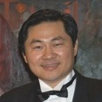
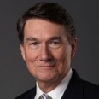
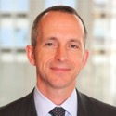
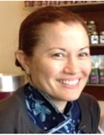
Senior Advisors
Wang Huiyao
Dr. Wang Huiyao is President of Center for China and Globalization (CCG), a leading think tank in China. He is also Vice Chairman of China Western Returned Scholars Association. In 2015, he was appointed Premier Li Keqiang to the Counselor Office of the State Council of China. He was a Visiting Fellow at Brookings Institution and a Senior Fellow at Harvard Kennedy School. Dr. Wang has published over 40 English and Chinese books and more than 100 articles and papers on global talents, education, Chinese entrepreneurs, Chinese returnees, Chinese MNCs and Chinese foreign investment.
John Holden
John L. Holden is CEO of the US-China Strong Foundation. In this role, he works to expand US-China Strong’s presence, programs and mission to create more productive relations between future American leaders and their Chinese peers. Prior to joining US-China Strong, Mr. Holden was Associate Dean at Peking University, a center for the interdisciplinary study of China at Peking University. He was also Professor of Management Practice at the Guanghua School of Management of Peking University. From 1998 to 2005 Mr. Holden was President of the National Committee on United States‐China Relations.
Robert Garris
Dr. Garris is the Global Director of Admissions at Schwarzman Scholars, where oversees the recruitment effort for elite scholars from around the world to join the highly selective 1-year Schwarzman Scholars master's program at Tsinghua University. Previously, he was a Managing Director at the Rockefeller Foundation, Senior Associate Dean at Columbia University SIPA, and Director of Admissions at Johns Hopkins University SAIS. Dr. Garris holds a PhD from the University of North Carolina at Chapel Hill.
Carol Rattray
Carol is Managing Director and Co-founder at Zoomdojo. Since the mid 1990’s, Carol has been investing, and advising primarily start-ups, in China and in the US, and was previously Vice President in the Capital Markets Group at Bankers Trust Company. In philanthropy, Carol is President and Co-Founder of the Rattray Kimura Foundation. She is also a member of the Board of Trustees of Bates College, The Asian Cultural Council, and the Re Foundation and a former member of the Board of The Nature Conservancy, New York State Chapter, The Orpheus Chamber Orchestra and The Friends of the Museum of the Chinese University in Hong Kong. Carol is also co-chair of The Asia Foundation’s Women’s Empowerment Program’s Lotus Circle Advisors and serves as a member of the Cornell University Council and The Arts and Sciences Advisory Council.

Slide 8
Our Supporters
“I appreciate the work that you do at GCC. China as you know is the great thematic of the 21st Century. It's going to require seriously bright, dedicated folks like you, who know the country, the culture, and the civilization, the language, and at the same time are specialists in their fields. Get that right, we can build some bridges which is serious, sustainable, and strong.”
Kevin Rudd, Former Prime Minister of Australia
“I would like to commend Global China Connection for putting together (the GCC Canadian Conference) and for advancing the ties of friendship and trade between our two countries.”
Stephen Harper, Then Prime Minister of Canada
“I applaud the students involved in GCC for their important work in linking our two nations.”
Debora Spar, Board Member of Goldman Sachs
“Organizations such as yours provide an important forum for business leaders, public officials, and scholars to connect with students in order to foster a dialogue that helps expand our mutual understanding, and broaden our worldview.”
Kirsten Gillibrand, U.S. Senator from New York
“We are grateful for the opportunity to collaborate once again with Global China Connection.”
Weiying Zhang, Former Dean Peking University’s Guanghua School of Management
7

Slide 9
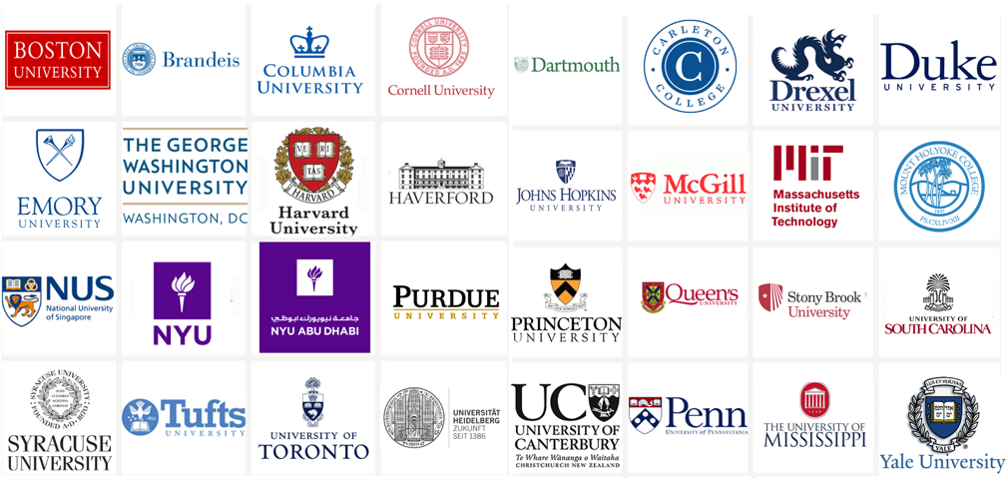
Select University Chapters
8
All chapters are officially recognized student clubs at their local universities.

Slide 10
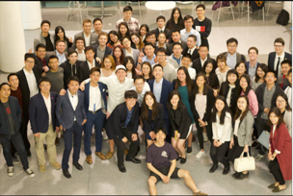
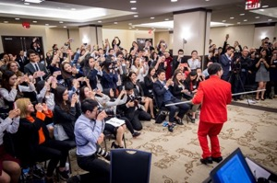
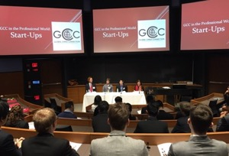
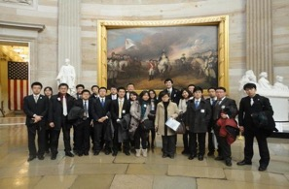
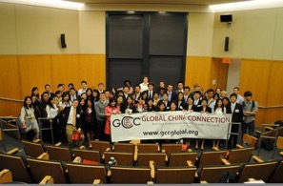
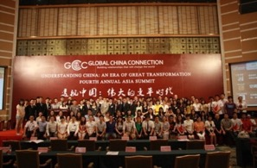
Major Events
2017 GCC World Summit
- Cornell University
2016 GCC Annual Summit
- New York University
2015 GCC World Fair
- Yale University
Hosting Peking and Tsinghua University Student Union
- Chapters in Boston, New York and Washington D.C.
2012 Harvard Chapter Conference
- Harvard University
2011 GCC Annual Asia Summit
- Peking University
9

Slide 11
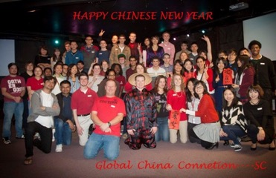
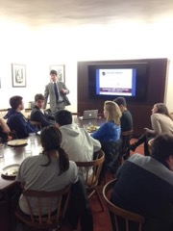
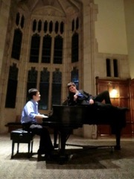
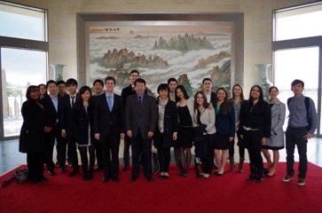
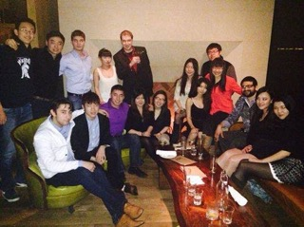
Local Events
University of South Carolina wishing GCC a Happy Chinese New Year
Job-hunting in China workshop at Yale University
GCCers serenading each other during the Princeton Annual Convention
GWU chapter visits the Chinese Embassy
10
NYU Chapter hanging out

Slide 12
Personal Stories

Slide 13
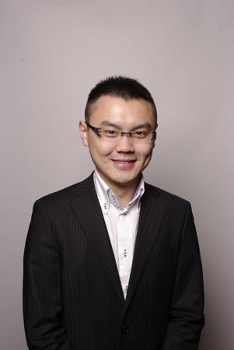
Who joins GCC?
GCC attracts smart, ambitious and hungry individuals who want to play a leading role in China's rise. We find common ground in leading an organization with a powerful platform that enables us create opportunities, solve problems and connect with decision makers in China and the US. GCC isn’t just a club - it is an identity.
After university, because of the management and leadership experience gained, GCC alumni are recruited by leading companies like BCG, Ford, Goldman Sachs, Google and Unilever.
DAVID ZHU
GCC Position: Former Trustee and Co-Founder
Hometown: Wuhan, China; Vancouver, Canada
Degree: Economics, Columbia University
Company: Founder, wondercv.com; Goldman Sachs

Slide 14
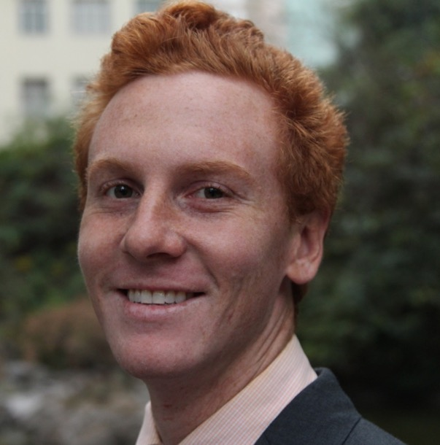
Why did you join GCC?
After a full semester in Shanghai, China, I knew I wanted to continue to focus on an international career in China. GCC provided the perfect resource for me to do this. When I joined I immediately started seeking out leadership opportunities and was able to leverage GCC's network and resources for the projects our Vanderbilt GCC wanted to do. It was quite entrepreneurial and I think that is the beauty of the GCC network. GCC provided the perfect bridge to use my academic learning to create professional opportunities. GCC has helped me have a network in the US and China to rely on for different areas of expertise and professional inquiries. As a young entrepreneur working to start a business in China, the counsel of fellow American and Chinese GCC members has been invaluable. So in a way GCC has not helped me to find a job, but create one.
EOIN BROWN
GCC Position: Shanghai Alumni Committee Member; Vanderbilt Chapter Executive Board Member
Hometown: Morrison, New Jersey
Degree: Human and Organizational Development, Vanderbilt University
Company: Moet Hennessy Diageo
13

Slide 15
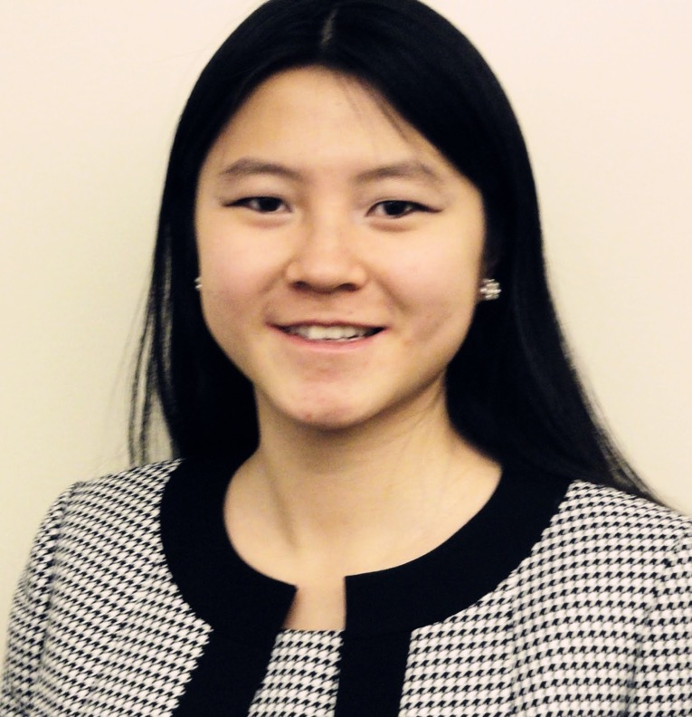
Why did you join GCC?
I was impressed with the high-profile speakers that GCC was able to bring and the size of attendance of students who had a vested interest in China [at the US Summit at Columbia University]. I started a chapter at Swarthmore that spring. In the capacity of founder and president, I ran weekly meetings and directed group activities, including all-campus Chinese cultural holiday celebrations, study breaks, and guest speaker talks. I also joined the Beijing Committee to organize the 2010 China Summit at Peking University. These experiences enhanced my interest in U.S.-China relations and honed my leadership skills. Now I edit the Global China Review and its monthly newsletters. As a fervent China watcher, it has been a great experience to summarize and analyze news about China for the GCC audience.
SHIRAN SHEN
GCC Position: Former Editor, Global China Review
Hometown: Shanghai, China
Degree: Political Science, Swarthmore College
Company: National Wildlife Federation
14

Slide 16
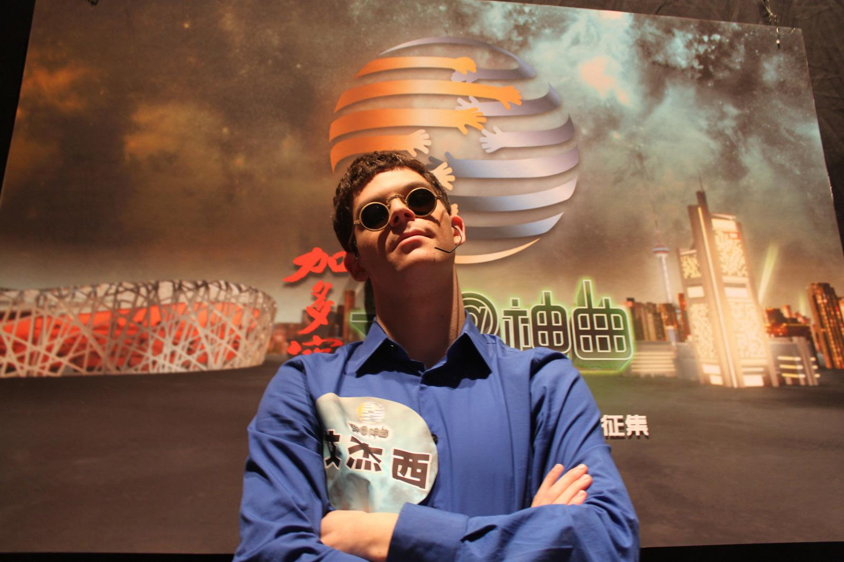
What type of friends have you made through GCC?
GCC was a great chance to meet many amazing Chinese people, both in the US and in China. Everyone who I have met in GCC is talented, intelligent, fun and ambitious. GCC has put me in touch with incredibly devoted and intelligent Chinese students spending years studying abroad in the US, as well s people like myself who are not from China but are interested in meeting peers from China with whom we can openly ask questions and learn from.
I take great comfort in knowing that if I find myself alone in China, I am surely just one phone call away with meeting up with these great GCC members I’ve met back in the US.
JESSE APPELL
GCC Position: Alumni Council Member; Former Associate Director of Communications
Hometown: Newton, Massachusetts
Degree: East Asian Studies/International Global Studies, Brandeis University
Company: Founder, Laugh Beijing
15

Slide 17
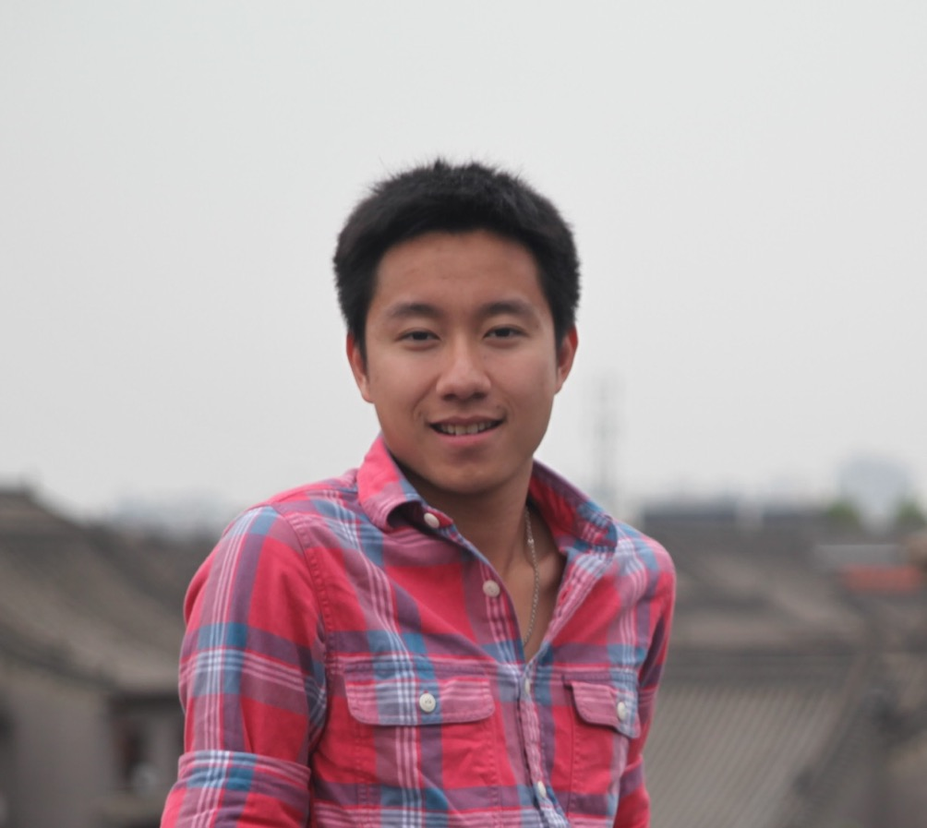
What type of skills have you gained through GCC?
Through the organization, I've gained leadership experience, professional skills and the ability to interact with senior people, significantly increasing my chances of receiving and passing interviews. Furthermore, it provided with a broad network of individuals who constantly supported me and taught me during the process. I've had the chance to work under and manage people from different backgrounds and geographical locations. This presented unique problems and unique experiences as compared to traditional campus organizations. The GCC experience gave me exposure that's unmatched by any other organization in college and helped me develop into the person I am today!
RANDY WAN
GCC Position: Former Trustee, Cornell Chapter President
Hometown: Los Angeles, California
Degree: Economics and China & Asia Pacific Studies, Cornell University
Company: Founder, Wujie Space; Boston Consulting Group (BCG)
16

Slide 18
And we’re just getting started.
Reaching our goals will not be easy.
But, with your support, we can
build relationships that will change the world.
www.GCCglobal.org

Slide 19
